Slide 1



Give a Time Cushion
Notes:
Give a time cushion at the end of the project
People get sick, documents get deleted, group members are irresponsible. For the unexpected and unaccounted for issues, set an earlier date than the actual due date for the project to be completed. By giving the team a few extra days as a time cushion, catastrophes and dilemmas can be solved by the time of the teacher’s due date.

Slide 2
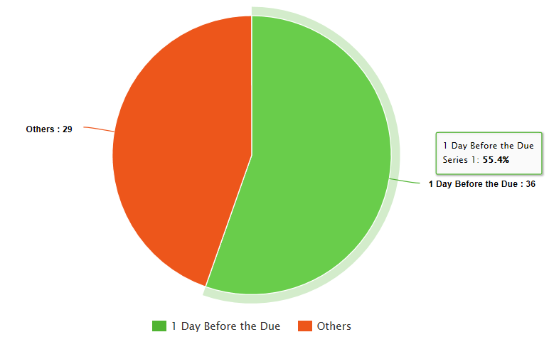
Project 1
Submission Report
Notes:
https://www.meta-chart.com/pie

Slide 3
Option1: When you access a remote Linux machine in the Linux lab, you shouldn’t use the "sudo" command, because you have no administrative rights.
Options 2-4: The "sudo" command is allowed on your virtual machine or local machine where you are a system administrator.

Slide 4
COMP 3500 Introduction to Operating Systems Operating System Design (cont.)
Dr. Xiao Qin
Auburn University http://www.eng.auburn.edu/~xqin
xqin@auburn.edu
Notes:
(1) 40 minutes Lec02b1-OS Design cont.ppt: Slides 1-10
(2) 5-10 minutes: Lec02b2-Project 2 overview (Move the project 2 introduction to Lecture 7).

Slide 5
Microsoft
Apple
Windows 10
iOS/MacOS

Slide 6
Monolithic Kernel
Microkernel

Slide 7
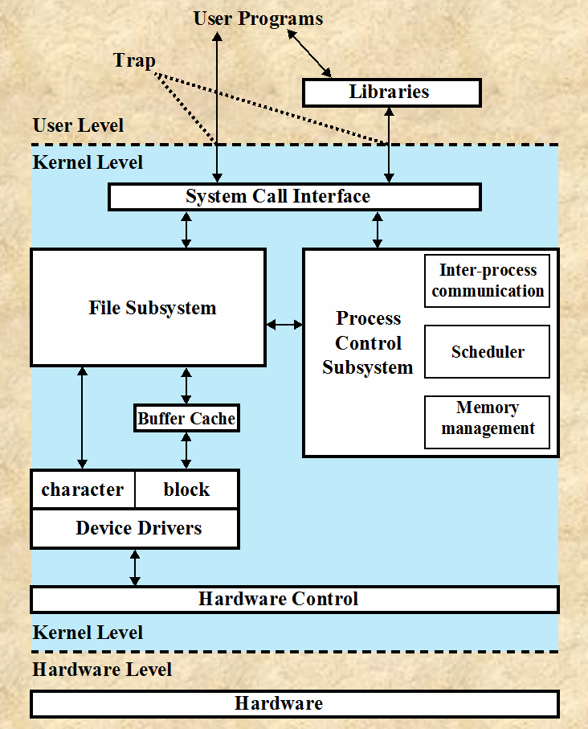
Recap:
Monolithic Kernel
Notes:
Recap: What are the pros and cons of the Monolithic Kernel ?
Benefits:
High performance. Performance overhead of user space to kernel space communication
Detriments:
difficult to port the operating system to new architectures

Slide 8
Recap: Microkernel System Structure
Notes:
In computer science, a microkernel (also known as μ-kernel) is the near-minimum amount of software that can provide the mechanisms needed to implement an operating system (OS). These mechanisms include low-level address space management,thread management, and inter-process communication (IPC).
Moves as much from the kernel into user space
Mach example of microkernel
Mac OS X kernel (Darwin) partly based on Mach
Communication takes place between user modules using message passing
Benefits:
Easier to extend a microkernel
Easier to port the operating system to new architectures
More reliable (less code is running in kernel mode)
More secure
Detriments:
Performance overhead of user space to kernel space communication

Slide 9
Exercise 0: Please work with your group member to develop a comparison table.
Hint: Basis for Comparison
Notes:
Recap: What are the pros and cons of the Monolithic Kernel ?
Benefits:
High performance. Performance overhead of user space to kernel space communication
Detriments:
difficult to port the operating system to new architectures

Slide 10
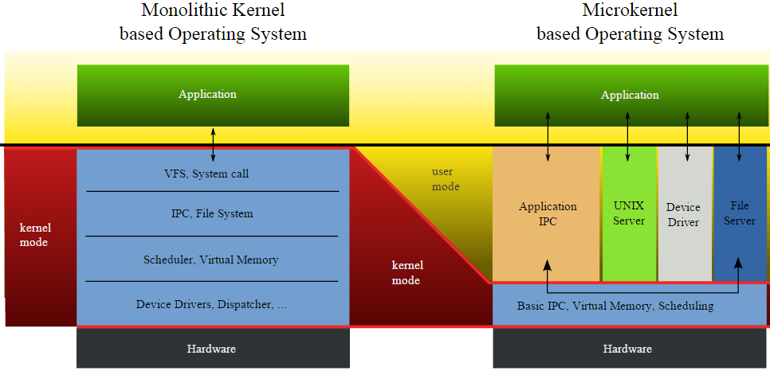
Monolithic Kernel vs. Microkernel
Exercise 1 (Plickers, 2-Min Group Discussions): Which structure should we use to build an OS for embedded systems (e.g., real-time robotic systems and smart watch)?
Monolithic Kernel
Microkernel
Random Pick
Notes:
bicycles versus cars: : both are forms of transportation that meet differing needs.
Reference: http://www.embedded.com/electronics-blogs/break-points/4025683/Microkernel-vs-monolithic.
Big monolithic OS: Linux and Windows
Linux's kernel is over 2 million lines of code. Window's is far bigger.
Microkernel: QNX, Minix
Monolithic kernels have been tremendously successful and do a yeoman's job of running the world's desktops and many embedded systems.
The philosophy behind microkernels is reliable operation (which is, in my opinion, far more important than the desire to pile features into already bloated code). Minix stresses a small kernel size. It's a whole lot easier to ensure that 4,000 lines of code are correct than 2 million.
the next great innovation in embedded processor design will be a very old idea: the memory management unit. An MMU in every CPU, coupled with code that isolates each operating-system component and task into distinct hardware-protected memory areas, can and will lead to much more reliable firmware.

Slide 11
Magic Trick: Monolithic Kernel vs. Microkernel
An
Operating System
Computer Hardware 1
Computer Hardware 2
Notes:
How to make “Monolithic Kernel” disappear?
If you can’t see the kernel, it is a microkernel.

Slide 12
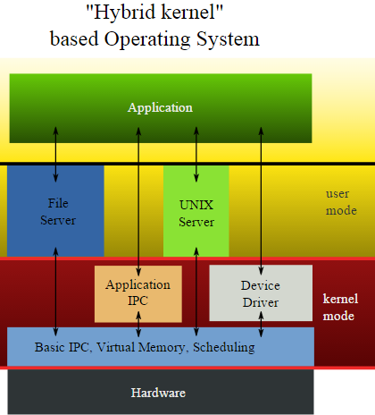
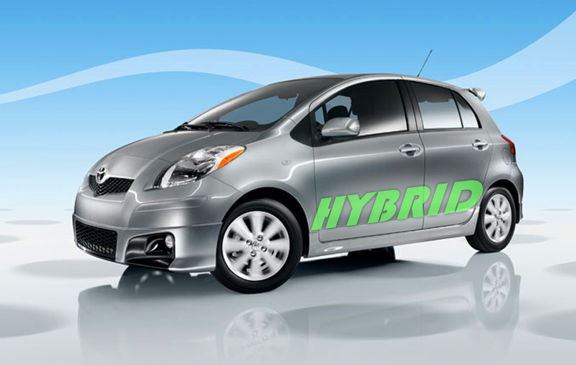


Hybrid Systems
Notes:
Most modern operating systems are actually not one pure model
Hybrid combines multiple approaches to address performance, security, usability needs
Linux and Solaris kernels in kernel address space, so monolithic, plus modular for dynamic loading of functionality
Windows mostly monolithic, plus microkernel for different subsystem personalities
Apple Mac OS X hybrid, layered, Aqua UI plus Cocoa programming environment
Below is kernel consisting of Mach microkernel and BSD Unix parts, plus I/O kit and dynamically loadable modules (called kernel extensions)

Slide 13
Exercise 2: What type of OS kernel does MacOS have? Why? A. Monolithic Kernel B. Microkernel C. Hybrid Kernel D. Tiny Kernel

Slide 14
iOS
Structured on Mac OS X, added functionality
Does not run OS X applications natively
Also runs on different CPU architecture (ARM vs. Intel)
Cocoa Touch Objective-C API for developing apps
Media services layer for graphics, audio, video
Core services provides cloud computing, databases
Core operating system, based on XNU kernel
Notes:
Apple mobile OS for iPhone, iPad
XNU is the computer operating system kernel developed at Apple Inc. since December 1996 for use in the macOS operating system and released as free and open-source software as part of the Darwin operating system. It is also used as the kernel for the iOS, tvOS, and watchOS operating systems. XNU is an abbreviation of X is Not Unix.^{[1]}
Originally developed by NeXT for the NeXTSTEP operating system, XNU was a hybrid kernel combining version 2.5 of the Mach kernel developed at Carnegie Mellon University with components from 4.3BSD and an Objective-C API for writing drivers called Driver Kit.^{[citation needed]}
Originally developed by NeXT for the NeXTSTEP operating system, XNU was a hybrid kernel combining version 2.5 of the Mach kernel developed at Carnegie Mellon University with components from 4.3BSD and an Objective-C API for writing drivers called Driver Kit.^{[citation needed]}
After Apple acquired NeXT, the Mach component was upgraded to 3.0,^{[citation needed]} the BSD components were upgraded with code from the FreeBSD project, and the Driver Kit was replaced with a C++ API for writing drivers called I/O Kit.^{[citation needed]}

Slide 15
Notes:
Reference: https://en.wikipedia.org/wiki/Android_(operating_system)
Android is a mobile operating system developed by Google, based on the Linux kernel and designed primarily for touchscreen mobile devices such as smartphones and tablets. Android's user interface is mainly based on direct manipulation, using touch gestures that loosely correspond to real-world actions, such as swiping, tapping and pinching, to manipulate on-screen objects, along with a virtual keyboard for text input. In addition to touchscreen devices, Google has further developed Android TV for televisions, Android Auto for cars, and Android Wear for wrist watches, each with a specialized user interface. Variants of Android are also used on notebooks, game consoles, digital cameras, and other electronics.

Slide 16
Exercise 3 (Plickers): What type of OS kernel does Android have?
A. Monolithic Kernel B. Microkernel C. Hybrid Kernel D. Tiny Kernel
Notes:
Developed by Open Handset Alliance (mostly Google)
Open Source
Similar stack to IOS
Based on Linux kernel but modified
Provides process, memory, device-driver management
Adds power management
Runtime environment includes core set of libraries and Dalvik virtual machine
Apps developed in Java plus Android API
Java class files compiled to Java bytecode then translated to executable than runs in Dalvik VM
Libraries include frameworks for web browser (webkit), database (SQLite), multimedia, smaller libc

Slide 17
Summary
OS Services
Basic Operating System Organization
Kernel Mode vs. User Mode
Monolithic Kernel
Microkernel

